Slide 1
WelCome

Slide 2
Project Title : - MediConnect
Presented by,
Omkar Gaikwad 23UCS034
Atharv Dhandale 23UCS029
Aradhy Jadhav 23UCS042
Suyash Jadhav 24UCS305

Slide 3
Introduction
Now a days access to accurate and personalized medicine recommendation remains a challenge for many individuals , people often rely on self diagnosis internet , searches , which can lead to incorrect medicine use, harmful drug .
The Mediconnect domain plays a crucial role in bridging gap between accessibility in powering user with informed choices while leveraging advancements in digital healthcare.

Slide 4
Problem statement
To design and develop the Mediconnect software which helps to patients by providing personalized medicine recommendation based on their symptoms , prescription and medicinal history .
The platform leverage AI and data analytics to ensure user to receive accurate and safe medicine suggestion .

Slide 5
Solution
A solution refers to a method or system designed to address a problem , meet a need or improve a process.
The Mediconnect solution operates within the healthcare domain focusing on enhancing access to accurate & personalized medication guidance for user.

Slide 6
Architecture
Login
Skin Care
Eye Care
Hair Care
Chat Box
Personal Info
Symptoms
Data Analysis
Database Mapping
Display Result

Slide 7
Objectives:-
Accurate Medical Guidance – Provide AI-driven personalized medicine recommendations
Specialized Health Sections – Dedicated solutions for Skin Care, Eye Care, and Hair Care.
User-Friendly Interface – Simple and intuitive platform for easy navigation.
Data Analytics – Analyze symptoms, prescriptions, and medical history for precision.
Secure Data Handling – Ensure privacy and confidentiality of user medical records
Real-Time Assistance – Integrated Chat Box for quick health-related queries.

Slide 8
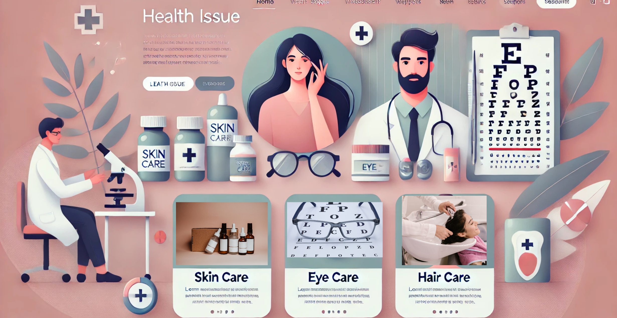
Usecase

Slide 9
Thank You

